Slide 1
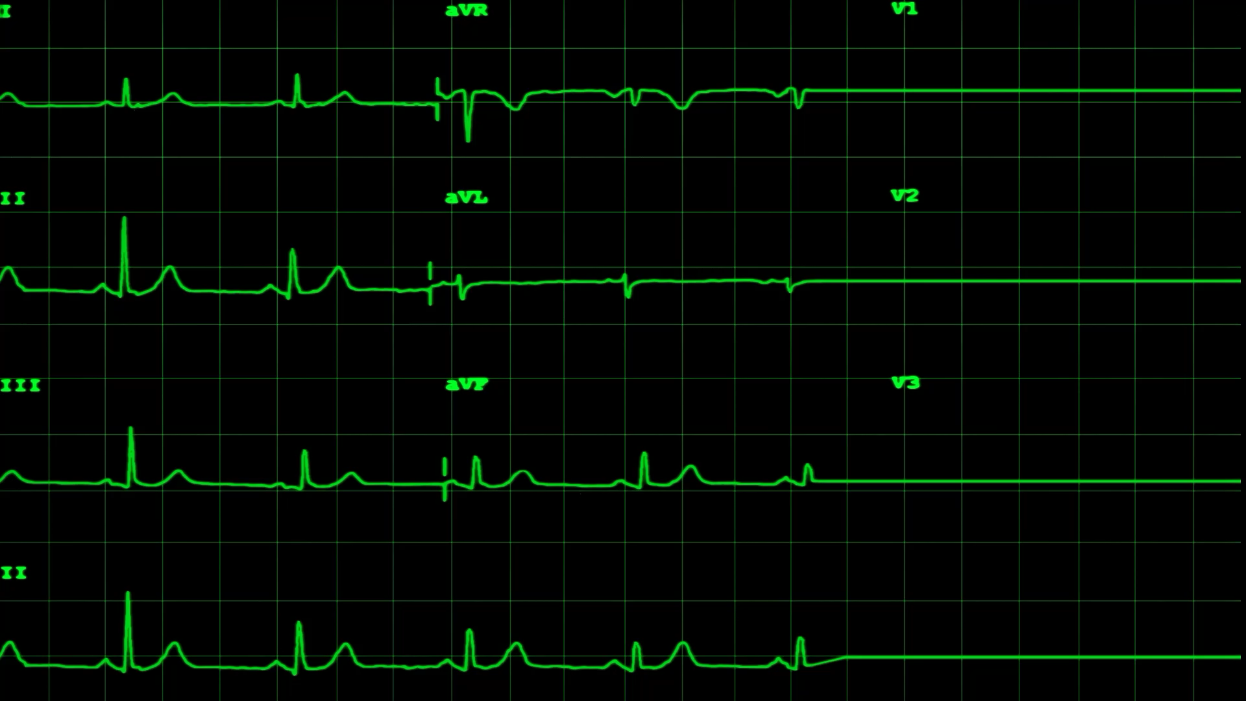
Heart Disease Prediction & ECG Image Classification of Cardiac Patients
Abhay Krishnan – H00481165
Aghil Subramanian – H00468078
Muhammad Hilal Aslam - H00484782
Edwin Binu – H00482595
Akul Vinod Adichikkatt – H00481041

Slide 2
PROJECT TIMELINE
R1 Project Topic, Direction
R2 Data Analysis and Exploration
R3 Clustering
R4 Training and Evaluation
R5 Neural Networks

Slide 3
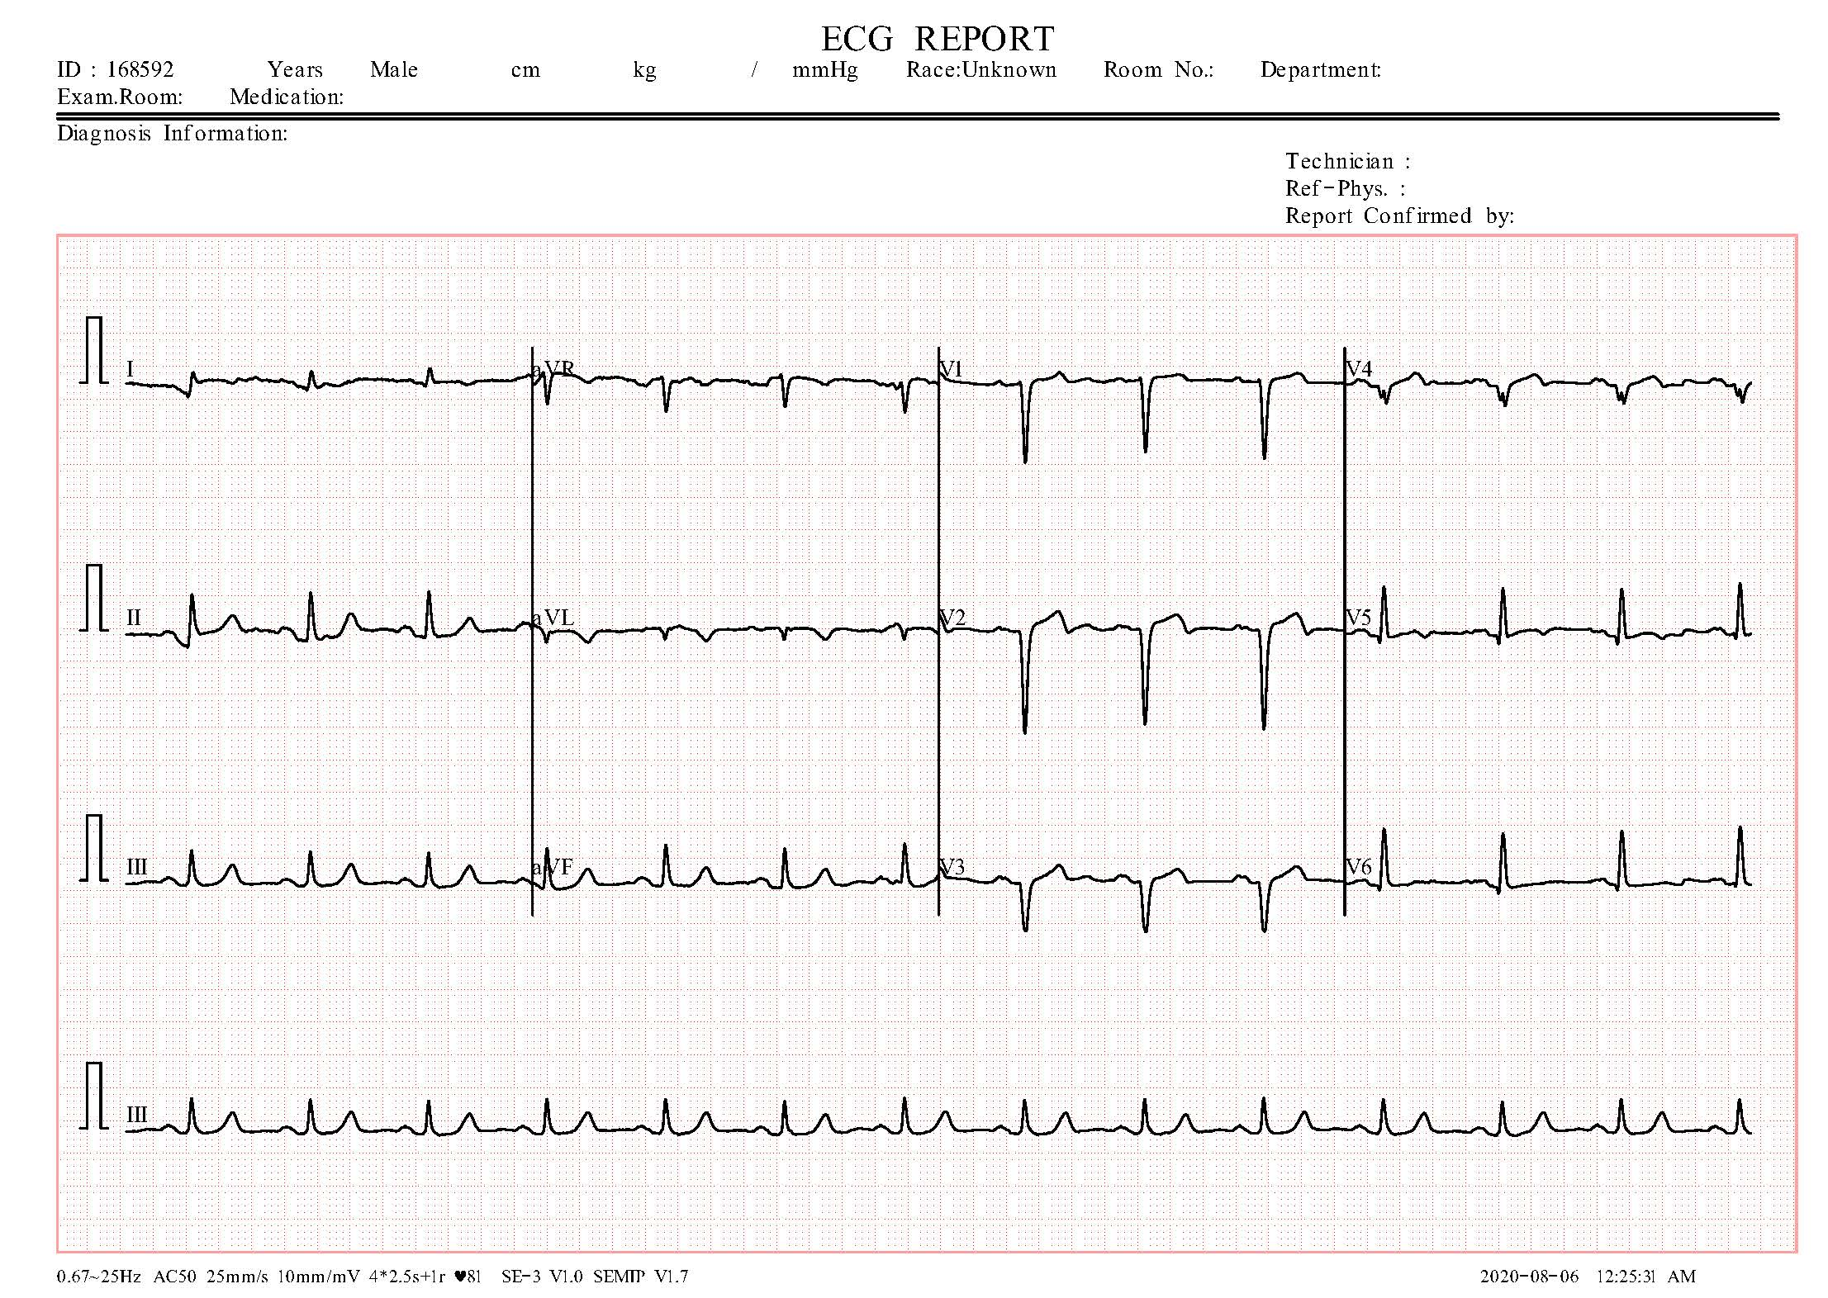
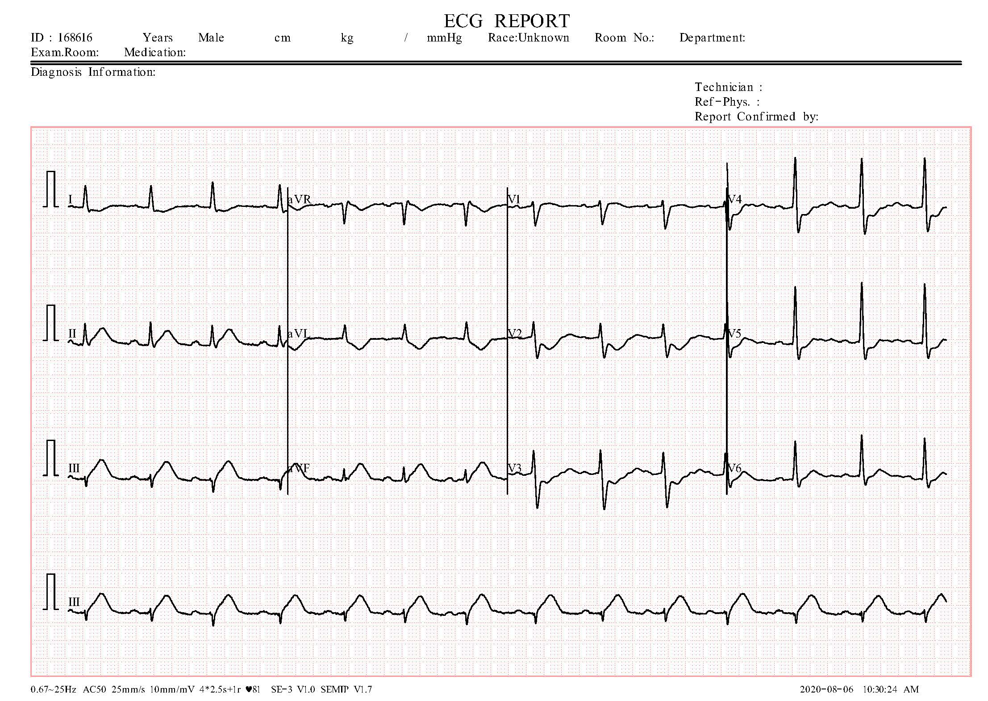
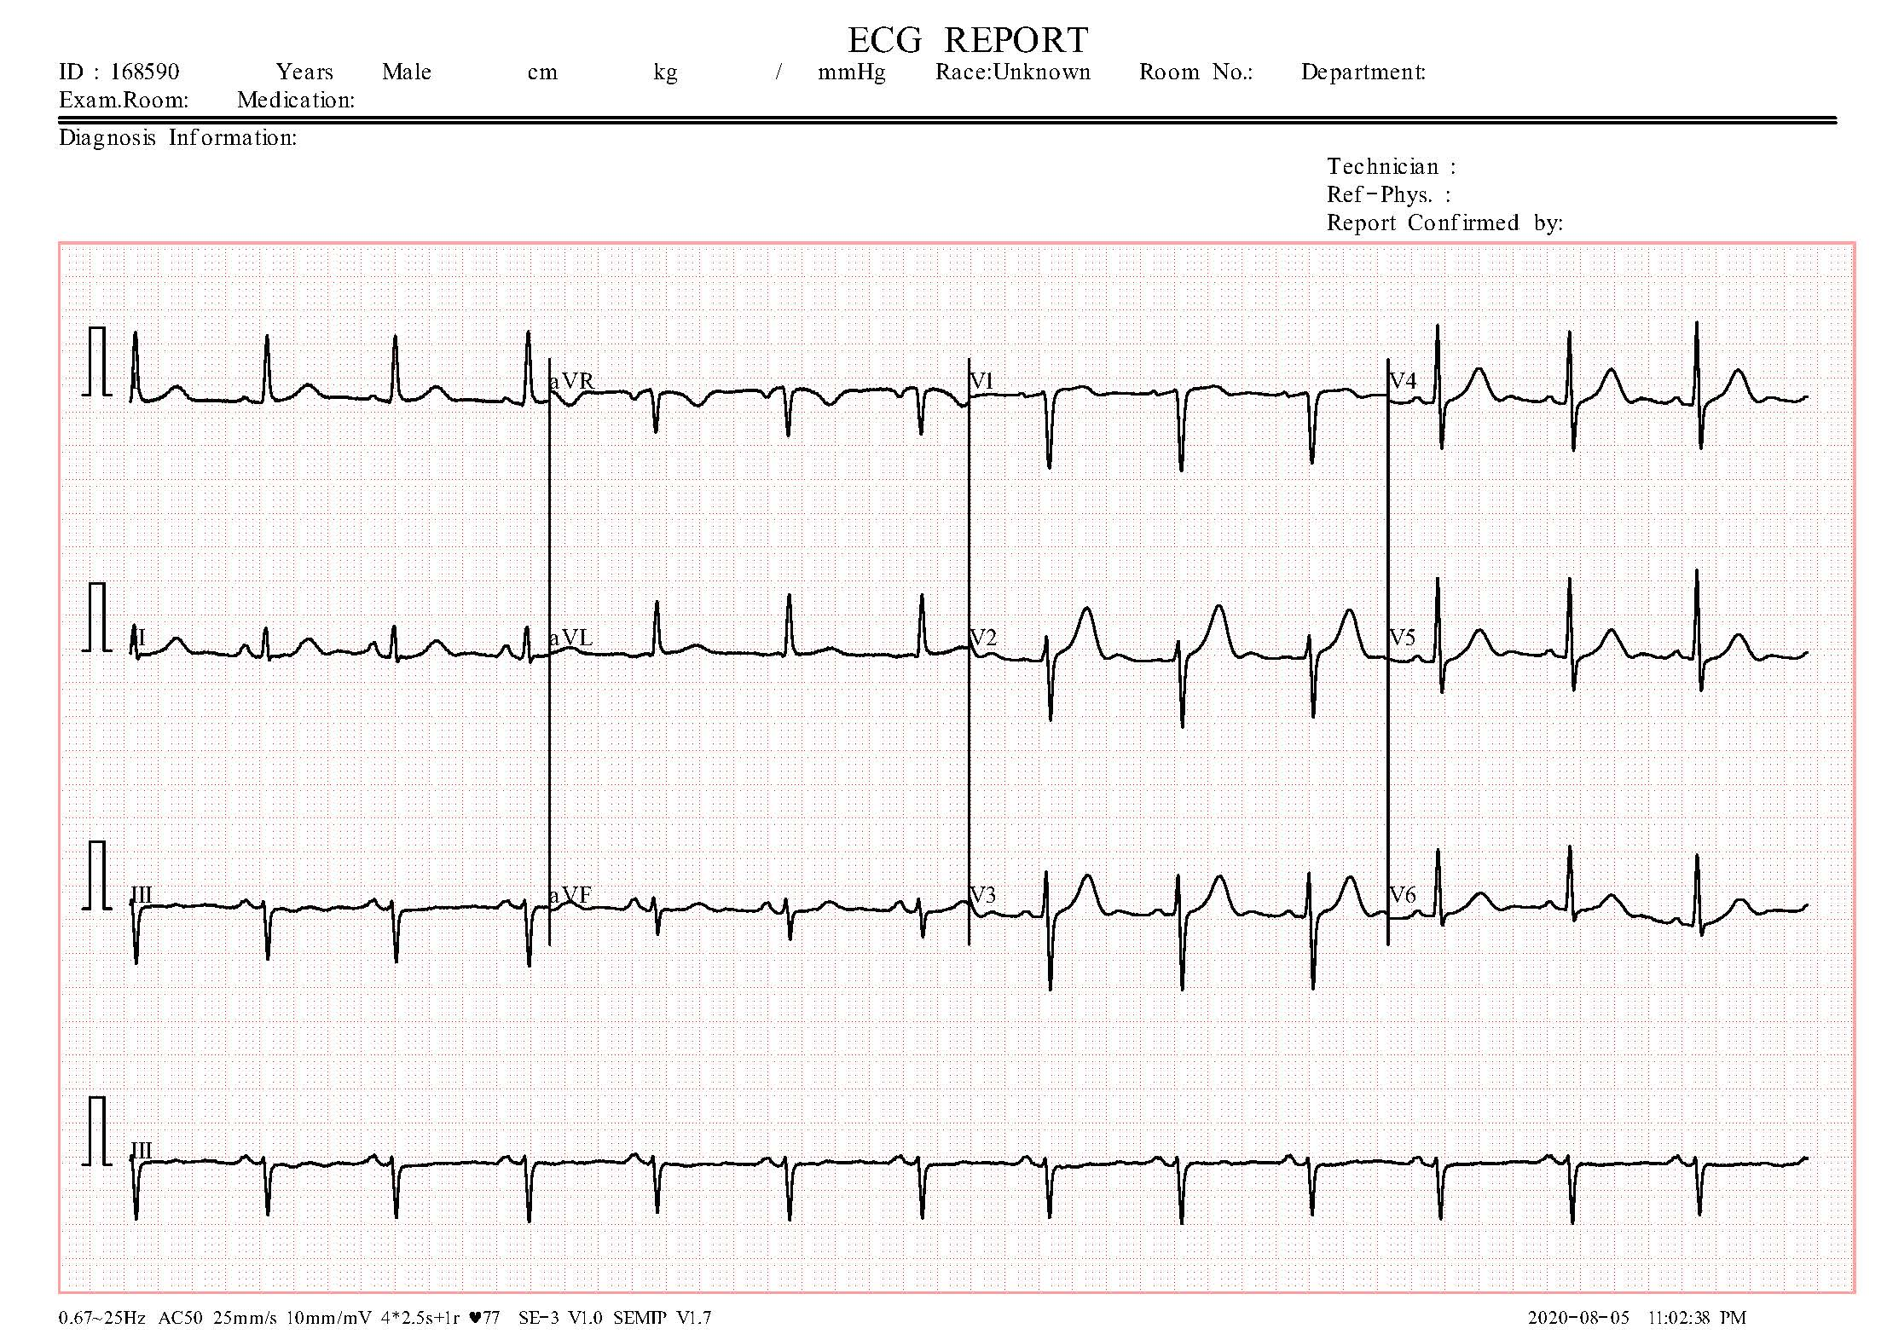
DATASET
The tabular dataset contains 1190 rows with 12 distinct attributes
The image dataset contains 11,000+ images
age | sex | chest pain type | resting bp s | cholesterol | fasting blood sugar | resting ecg | max heart rate | exercise angina | oldpeak | ST slope | target
40 | 1 | 2 | 140 | 289 | 0 | 0 | 172 | 0 | 0 | 1 | 0
49 | 0 | 3 | 160 | 180 | 0 | 0 | 156 | 0 | 1 | 2 | 1
37 | 1 | 2 | 130 | 283 | 0 | 1 | 98 | 0 | 0 | 1 | 0
48 | 0 | 4 | 138 | 214 | 0 | 0 | 108 | 1 | 1.5 | 2 | 1
54 | 1 | 3 | 150 | 195 | 0 | 0 | 122 | 0 | 0 | 1 | 0
39 | 1 | 3 | 120 | 339 | 0 | 0 | 170 | 0 | 0 | 1 | 0
45 | 0 | 2 | 130 | 237 | 0 | 0 | 170 | 0 | 0 | 1 | 0
54 | 1 | 2 | 110 | 208 | 0 | 0 | 142 | 0 | 0 | 1 | 0
37 | 1 | 4 | 140 | 207 | 0 | 0 | 130 | 1 | 1.5 | 2 | 1
48 | 0 | 2 | 120 | 284 | 0 | 0 | 120 | 0 | 0 | 1 | 0
37 | 0 | 3 | 130 | 211 | 0 | 0 | 142 | 0 | 0 | 1 | 0
58 | 1 | 2 | 136 | 164 | 0 | 1 | 99 | 1 | 2 | 2 | 1
39 | 1 | 2 | 120 | 204 | 0 | 0 | 145 | 0 | 0 | 1 | 0
49 | 1 | 4 | 140 | 234 | 0 | 0 | 140 | 1 | 1 | 2 | 1
42 | 0 | 3 | 115 | 211 | 0 | 1 | 137 | 0 | 0 | 1 | 0
54 | 0 | 2 | 120 | 273 | 0 | 0 | 150 | 0 | 1.5 | 2 | 0
38 | 1 | 4 | 110 | 196 | 0 | 0 | 166 | 0 | 0 | 2 | 1
43 | 0 | 2 | 120 | 201 | 0 | 0 | 165 | 0 | 0 | 1 | 0
60 | 1 | 4 | 100 | 248 | 0 | 0 | 125 | 0 | 1 | 2 | 1
36 | 1 | 2 | 120 | 267 | 0 | 0 | 160 | 0 | 3 | 2 | 1
43 | 0 | 1 | 100 | 223 | 0 | 0 | 142 | 0 | 0 | 1 | 0

Slide 4
Objective
The Aim is to build predictive models using structured health data using various classifiers like Logistic Regression, Decision Trees, Random Forest… to analyze and predict heart disease using attributes such as cholesterol levels, chest pain types, and blood pressure
For image datasets, the aim is to applying deep learning techniques, such as multilayer perceptron (MLP) & convolutional neural networks (CNNs), these visual patterns can be automatically analyzed to classify different types of heart abnormalities, such as arrhythmias, ischemia, or myocardial infarction.

Slide 5
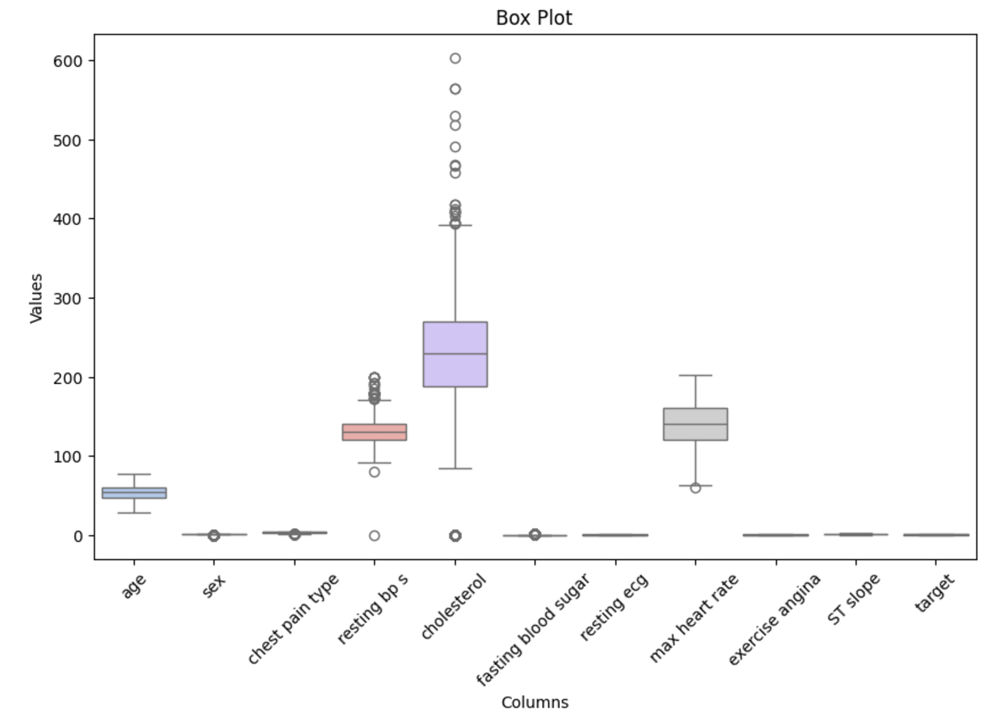
DATA PREPROCESSING
Checking Outliers
Checking for Null Values
Train test Split
Remove Outliers
Box plot to Check outliers

Slide 6
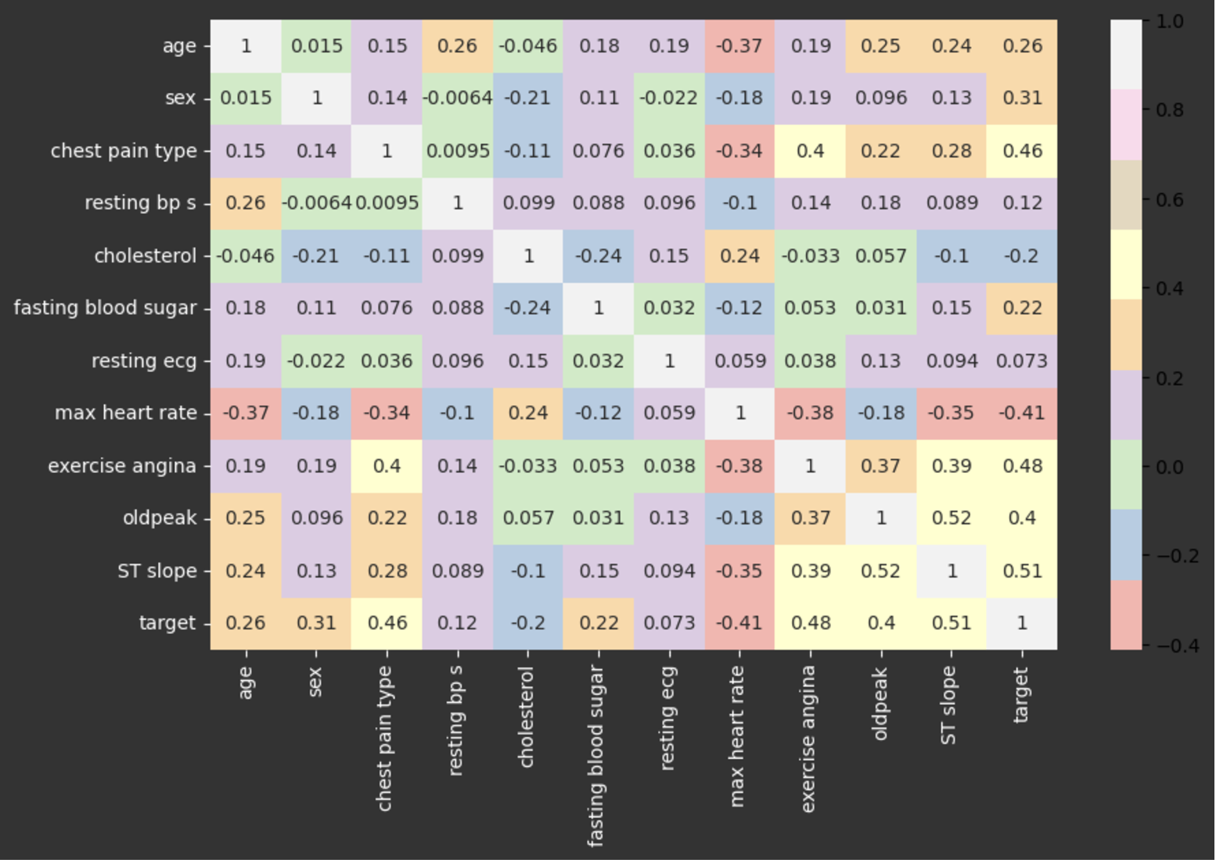
Correlation Matrix
TakeAways
Variables like chest pain type, exercise angina, ST slope, max heart rate, and oldpeak show strong correlations with the target variable, indicating these attributes are the important predictors of heart disease.​
Age, fasting blood sugar, and sex are moderately correlated with the target, indicating they also contribute but are not as strongly indicative as other variables.​
Cholesterol and resting blood pressure show weak correlations with heart disease in this dataset, suggesting they may not be the most significant predictors in this context.​

Slide 7
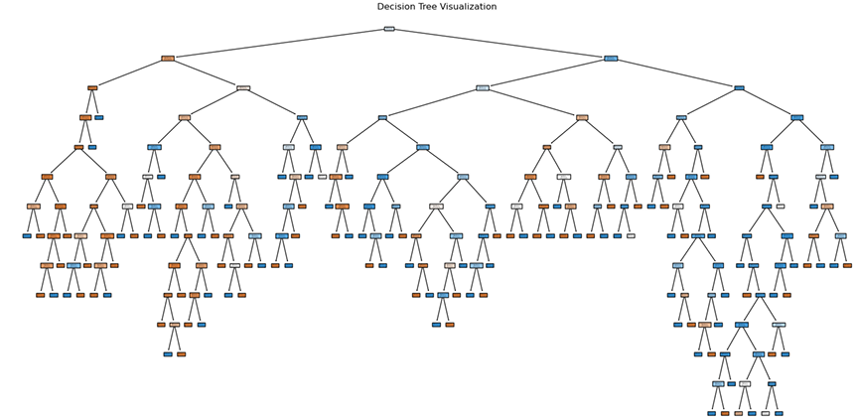
Decision Tree
Notes:
Used Grid Search Cv to find the hyperparamenters for decision tree. 3 max split 13 max depth

Slide 8
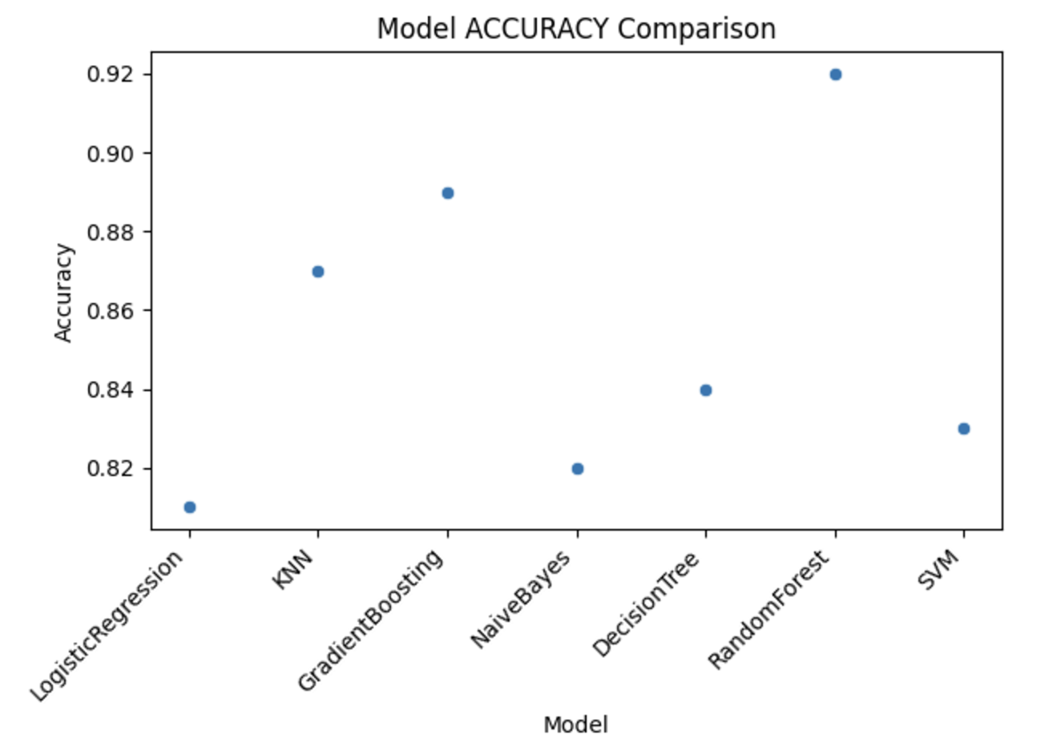
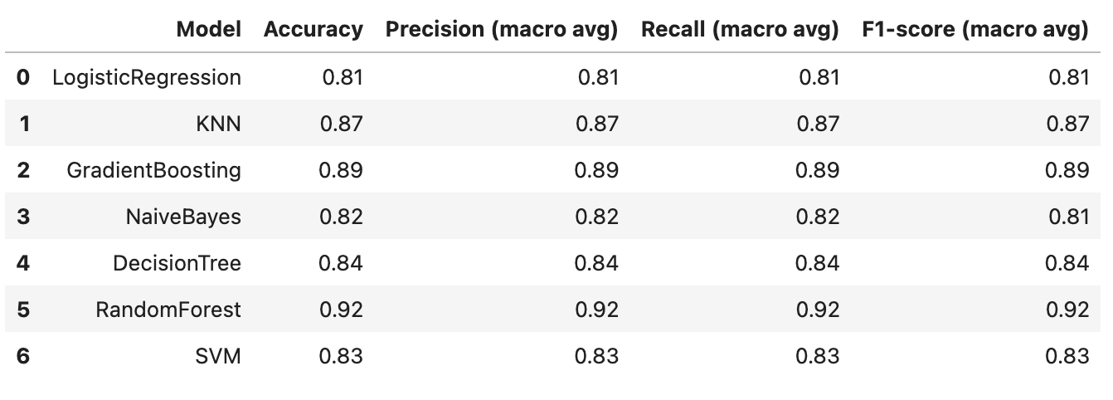
Model Accuracy Comparison of classification
Notes:
Train test split of 20 80

Slide 9
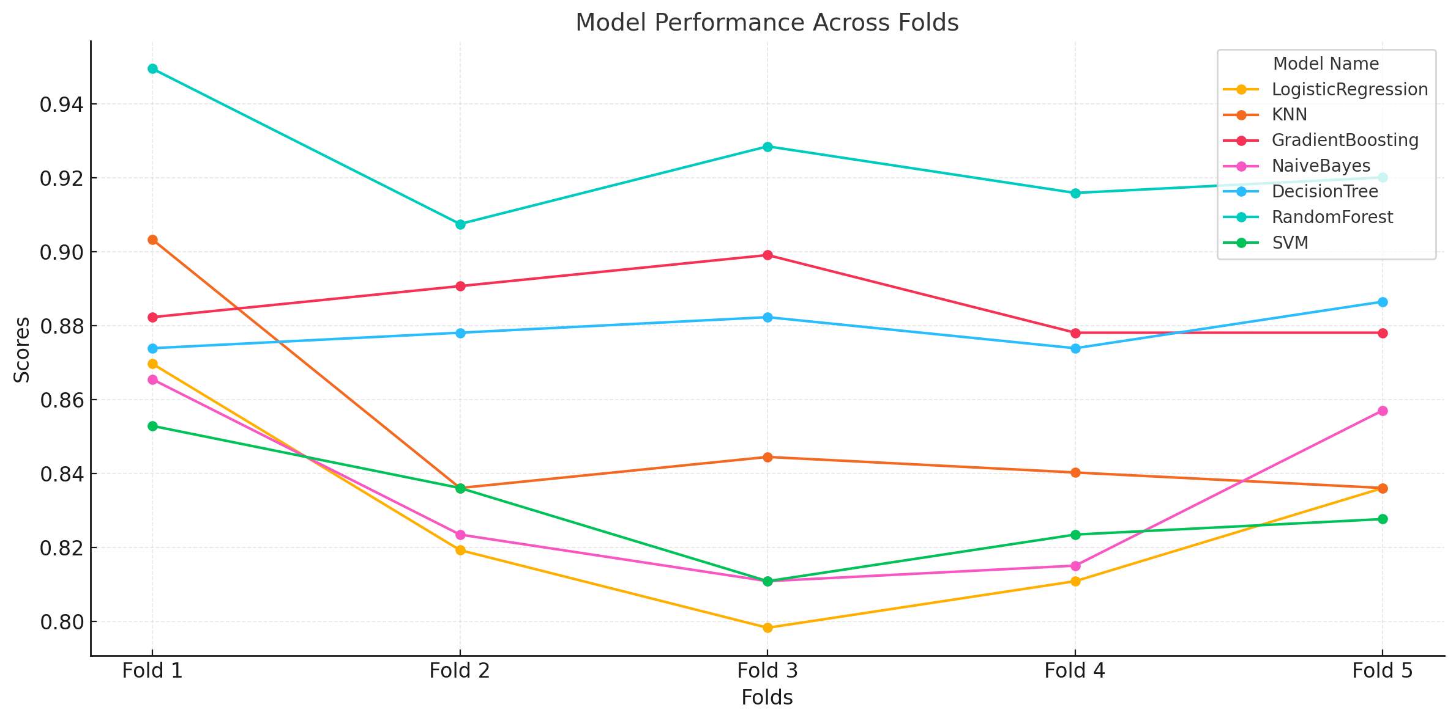
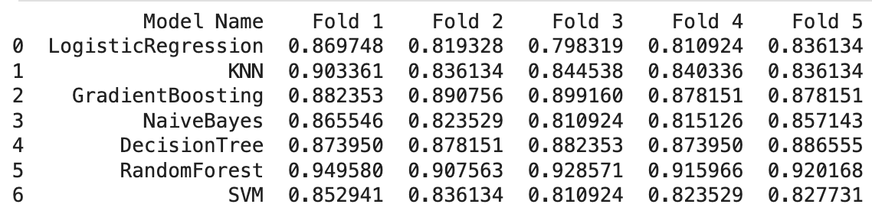
Model Accuracy Comparison after classification using K fold
Notes:
K fold split of 5 , 4 Testing and 1 validation

Slide 10
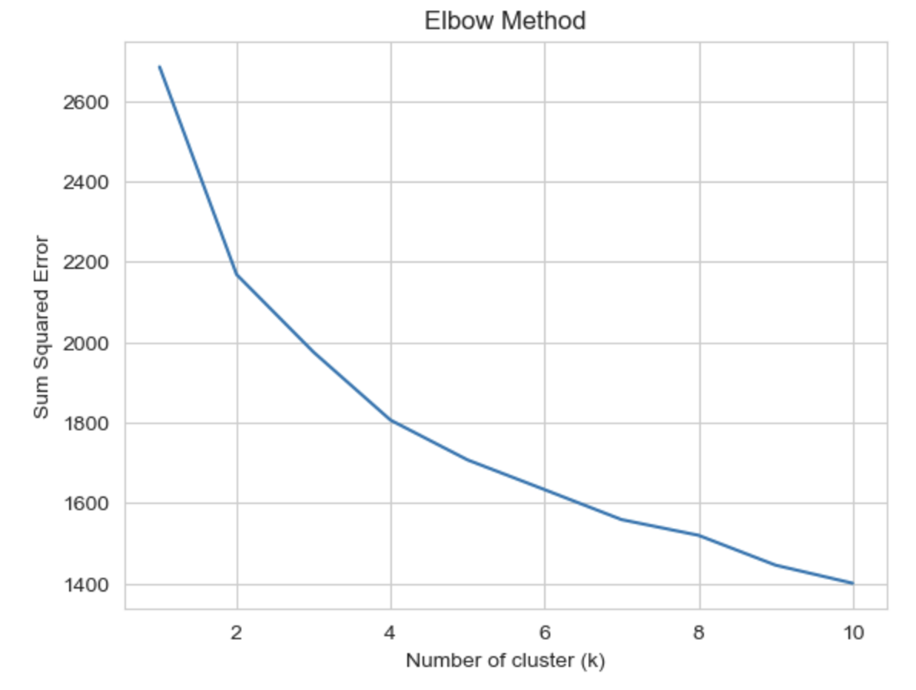
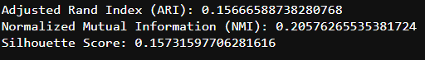
Clustering
We have used K means for clustering process and found the best K value 5 using the elbow method.
Elbow Method for K estimation
K mean clustering score

Slide 11
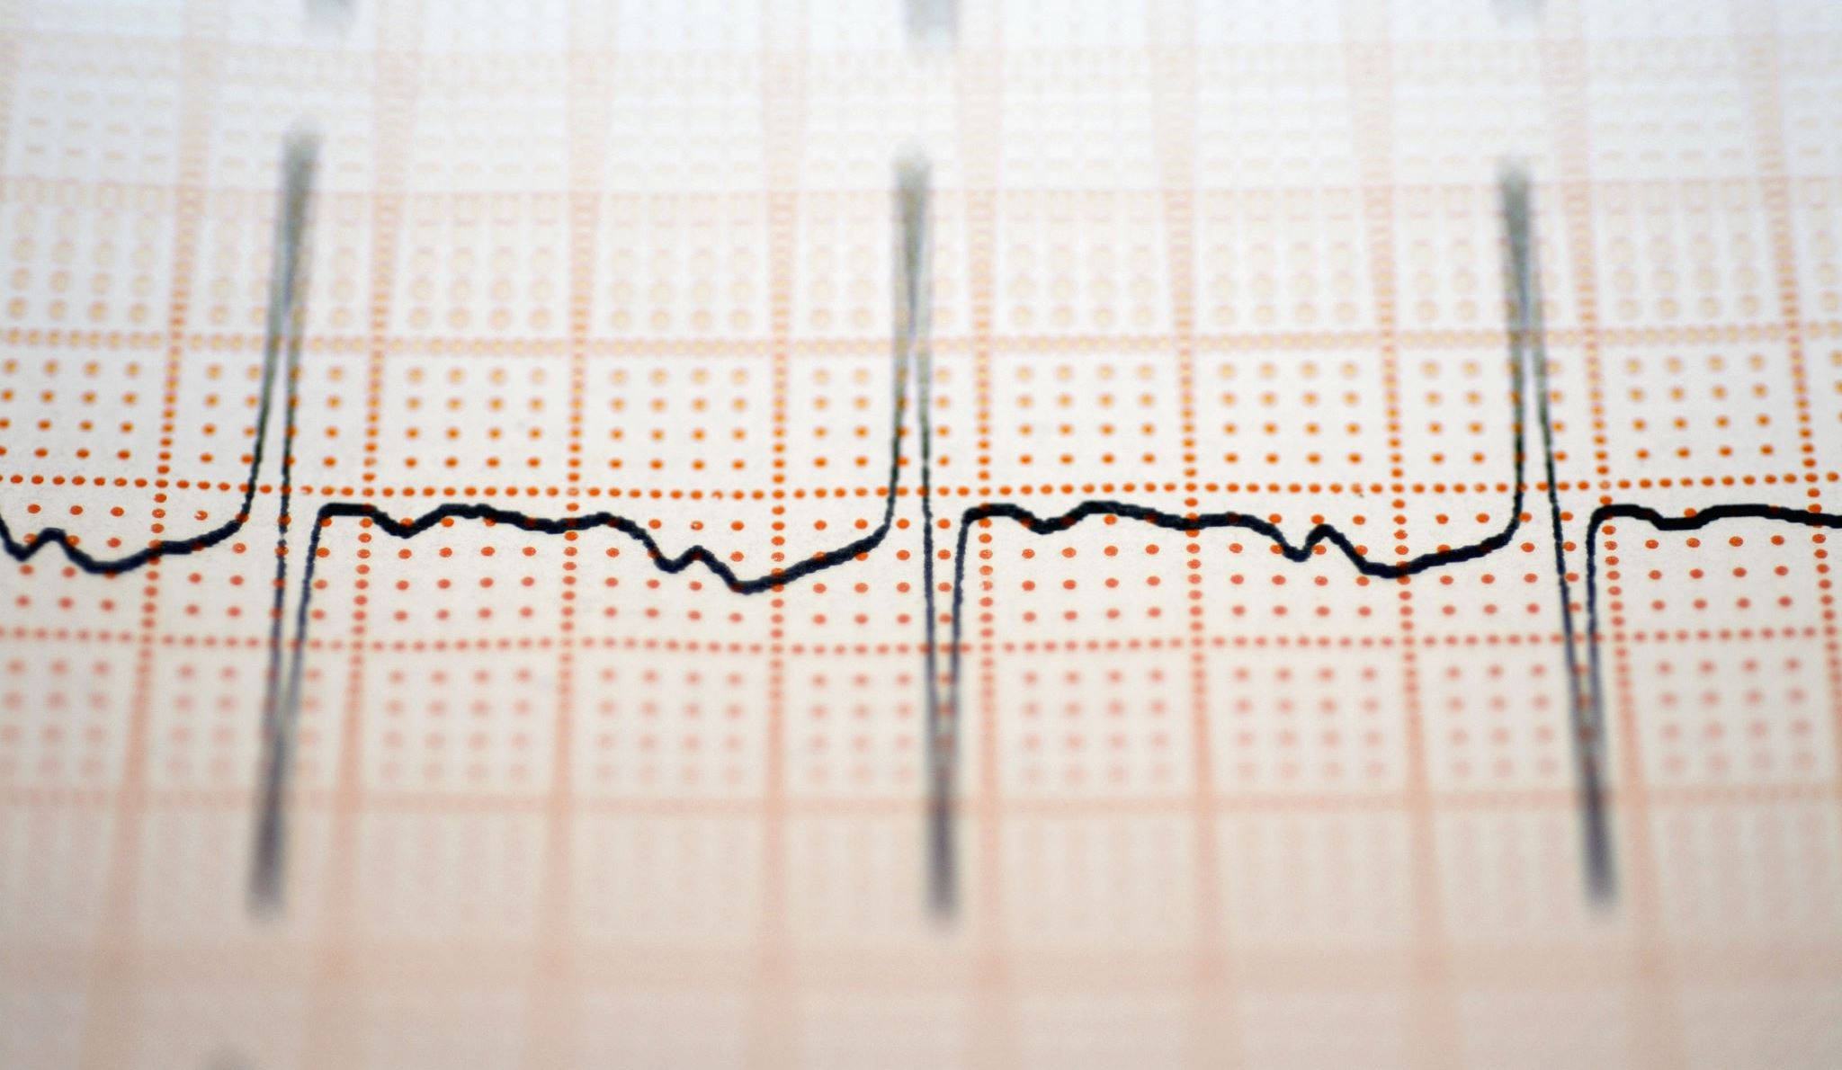
Image dataset classification
Data loading and inspection
Data Splitting
Data augmentation
We aim to classify the images into 4 categories
ECG images of Myocardial Infraction Patients
ECG images of Patient that have abnormal heartbeat
ECG images of patient that have history of MI
Normal person ECG image
We are using two models and determine which generates better classification accuracy
MLP
CNN
Notes:
U

Slide 12
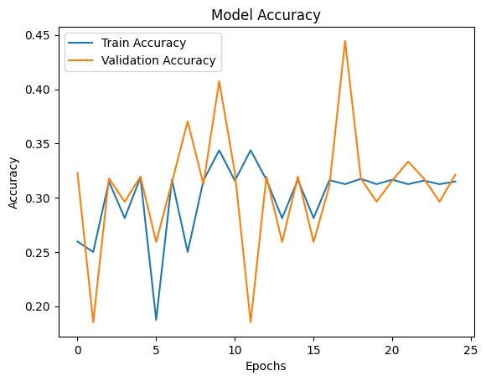
MLP

Slide 13
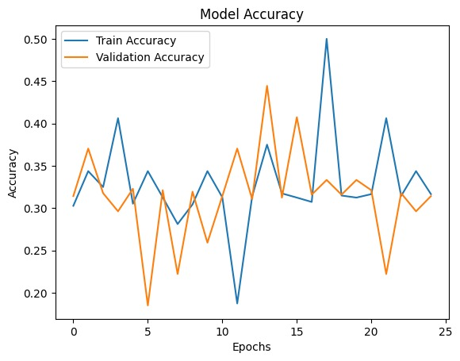
CNN

Slide 14
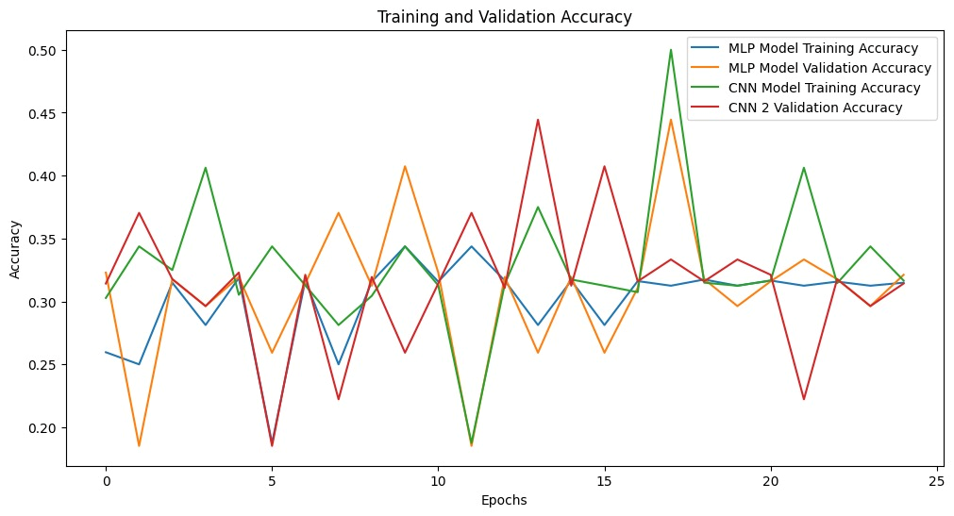
Comparing both MLP and CNN

Slide 15
CHALLENGES FACED
The output while using CNN was Overfitting for L1 regularization
In K means since this is a binary classification dataset, the clustering may not perfectly align with the target variable because clustering is unsupervised
SOLUTIONS
L2 regularization was used for normalization

Slide 16
Conclusion
Dataset 1 HeartDiseaseClassification.ipynb
Among all models tested, Random Forest consistently had shown the best performance across different metrics (Accuracy, Precision, Recall, and F1-score) •
Without K-Fold validation, the Random Forest achieved an accuracy of 93%. •
K-Fold cross-validation improved the accuracy for most models, especially Random Forest and Gradient Boosting. •
After applying K-Fold cross-validation, the accuracy of Random Forest increased to 95% •
The scores (ARI: 0.1567, NMI: 0.2058, and Silhouette: 0.1573) indicate that the clustering structure is weak, suggesting the data may not be naturally separable into distinct clusters or the features may need more preprocessing or feature engineering. The Random forest is the more reliable and accurate algorithm for this dataset, with a accuracy of 95 %.
Dataset 2 ECGImageClassification.ipynb
Both models have high variability in accuracy across epochs, which is due to Insufficient Training data or Noisy Data
But we can say the best among the both models is CNN model.

Slide 17
Group Declaration
Edwin Binu - – Data Preparation and GridSearchCV
Abhay Krishnan – Algorithm and K Fold
Aghil Subramanian Kizhukkulathil – Elbow Method and KMeans
Akul Vinod Adichikkatt – Data Preparation and MLP Algorithm
Muhammad Hilal Aslam - Graphs and CNN Algorithm

